Slide 1

APPLIED SCIENCE AND ENGINEERING PROJECT
END-SEMESTER ASSESSMENT
MEDICONNECT: PATIENT MANAGEMENT APPLICATION
Course: AIML
Div: B
ASEP Group No. : 4
Date : 01/03/25
PRESENTED BY :
Name | Roll No. | PRN
Shubhra Desai | 19 | 12412117
Arnav Deshmukh | 20 | 12414249
Himanshu Deshmukh | 21 | 12414955
Sanskar Deshpande | 22 | 12414328
Devang Damkondwar | 23 | 12414260
Atharva Devikar | 24 | 12410080
Ishwari Dhale | 25 | 12411884
PROJECT GUIDE:
PROF. VISHWESH RAGHUNATH DESHMUKH
DEPARTMENT OF ENGINEERING SCIENCES AND HUMANITIES (DESH) VISHWAKARMA INSTITUTE OF TECHNOLOGY, PUNE

Slide 2
OBJECTIVES
Streamlines Workflows: For the doctors as well as the patients into one efficient and user-friendly platform.
Patient Management: Collects and manages patient data securely.
Doctor Support: Simplifies prescription assignment and follow-up scheduling.
Automated Notifications: Reminds patients and doctors of appointments.

Slide 3





TOOLS USED
FIGMA: To design UI and UX for the website.
VS CODE: Utilized development of HTML as well as CSS. SQL Lite: To handle database. PYCHARM: Was used to handle python along with Django. TWILIO: To send appointment as well as emergency messages to patients.

Slide 4
METHODOLOGY IMPLEMENTED
Designed the website using Figma.
Created a website framework using HTML and CSS.
Used MySQL for Database.
Used API to connect frontend and SQL with backend.
Used Python and Django for backend.

Slide 5
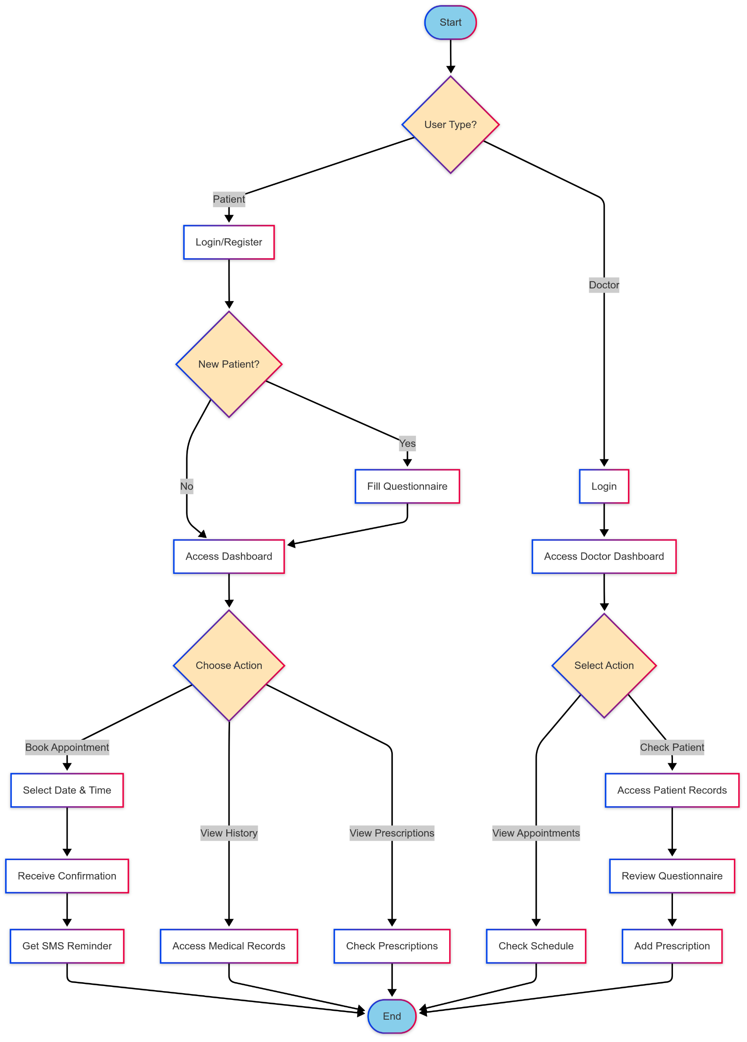
This is how the frontend will work.

Slide 6
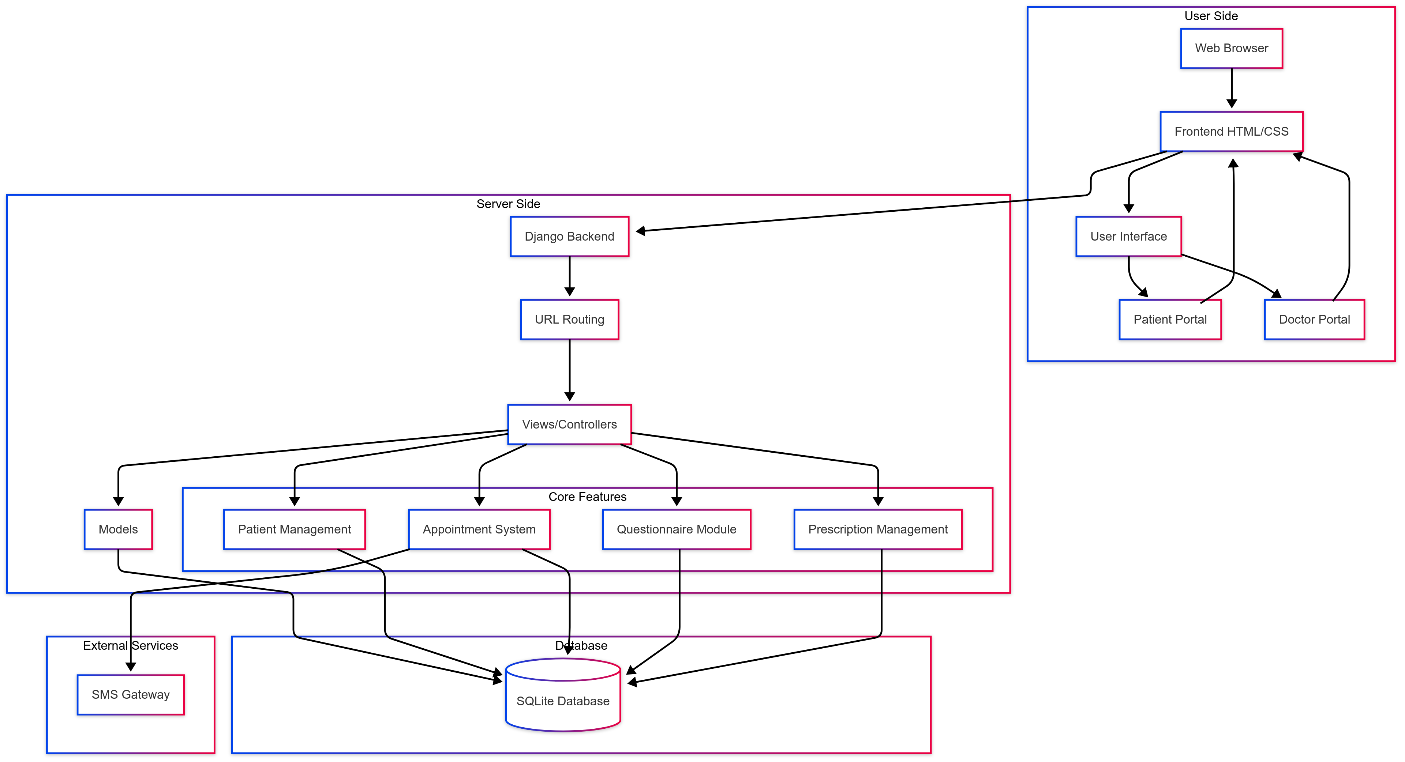
This is how our backend systems will work.

Slide 7
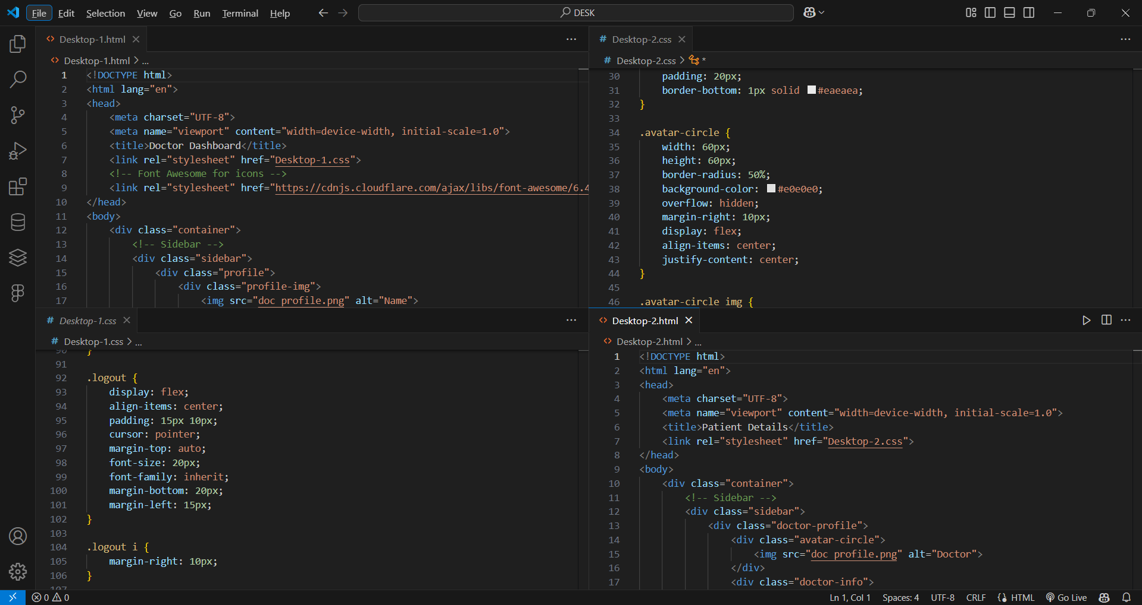
CODE SNIPPETS - HTML & CSS

Slide 8
CODE SNIPPETS - PYTHON

Slide 9
Results and Discussion
After everything was done while testing we encountered some bugs within our website which we’ve fixed.
There were question about security of patient data, how is it stored and who can access it?
Patients will appreciate the ability to check their queue status in real time, reducing unnecessary waiting.
Staff will likely discuss how the system simplifies their workflow by keeping track of patient details.
There could be discussions about how well the platform integrates with existing hospital systems.
Some doctors might need time to adapt to digital patient management.
Users might compare it with other hospital queue management or medical record platforms.

